Slide 1
K8s Introduction

Slide 2
Agenda
K8s Architecture
Basic Concepts
  Pod
  Replicaset
  Deployment
  Service
    NodePort
    ClusterIP
    LoadBalancer
  Horizontal Pod Autoscaler
K8s Local Architecture

Slide 3
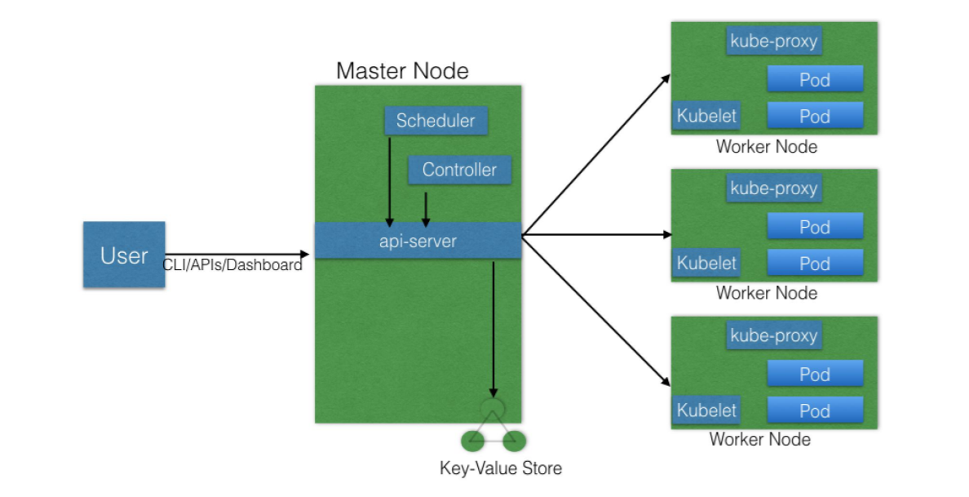
K8s Architecture

Slide 4
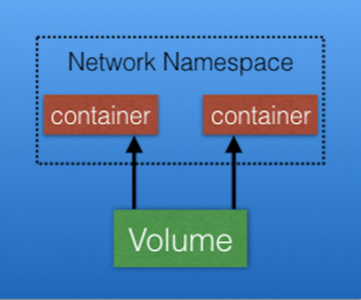
Basic Concepts: Pods
Pod: a logical collection of one or more containers which:
  Are scheduled together on the same host
  Share the same network namespace
  Mount the same external storage

Slide 5
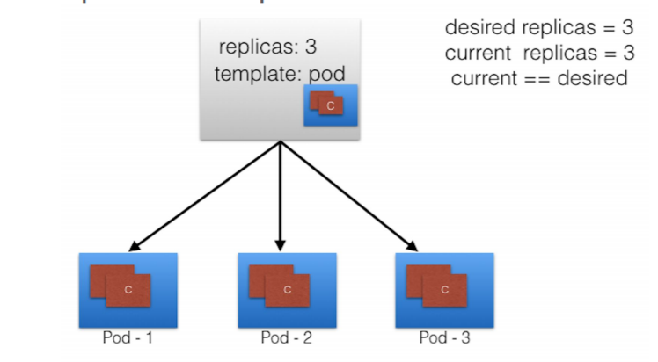
Basic Concepts: Replicaset
Always keep the number of pods correct

Slide 6
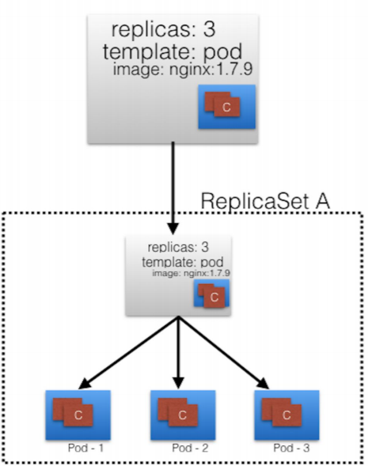
Basic Concepts: Deployment

Slide 7
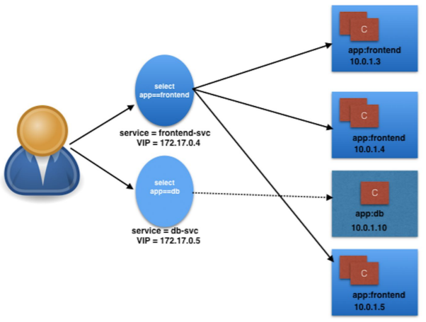
Basic Concepts: Service
Logically groups pods and policies to access them
This is done via labels and selectors

Slide 8
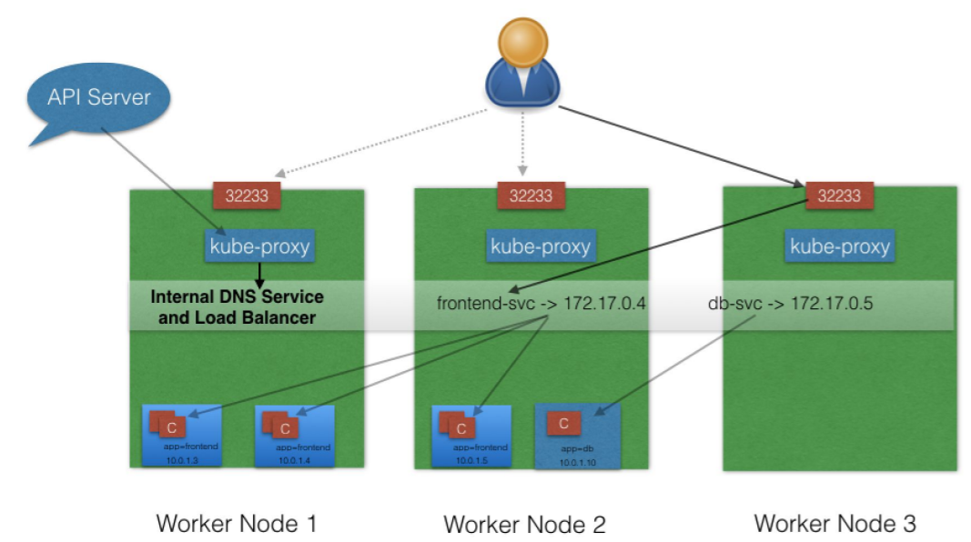
Basic Concepts: Service : NodePort

Slide 9
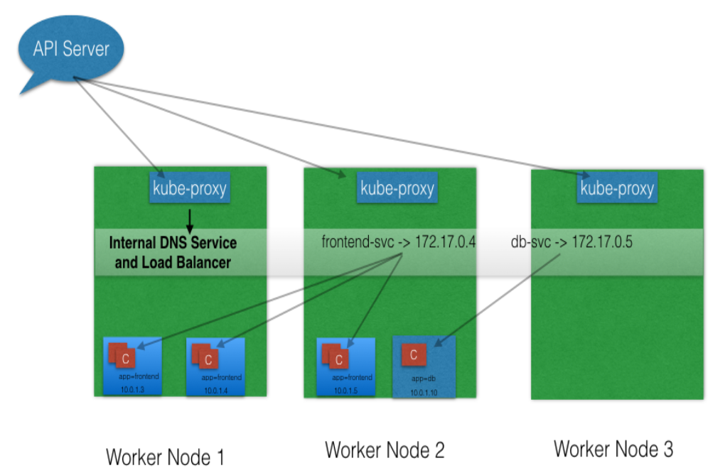
Basic Concepts: Service : ClusterIP

Slide 10
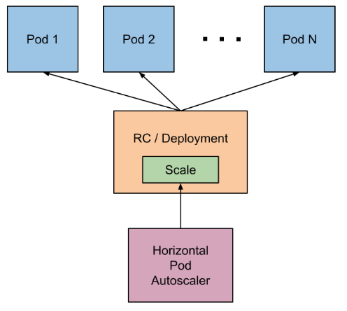
Basic Concepts: Horizontal Pod Autoscaler

Slide 11


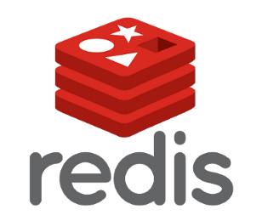
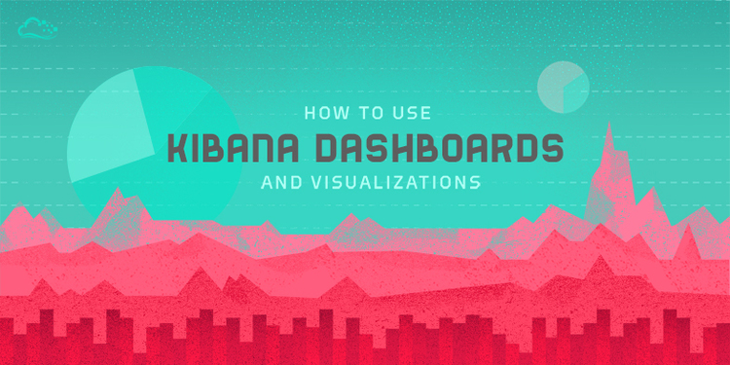


K8s Local Architecture
Redis GUI
Redis GUI Client
Port: 30090

